Slide 1
Introduction to computer basics
Computers are machines that perform tasks or calculations according to a set of instructions, or programs.
Computers play a major role in our daily lives
Computers work through an interaction of hardware and software.
Hardware refers to the components of a computer that you can see and touch, including the case and everything inside it
Software is an instruction or program that executes some jobs when it runs on a computer
Two type ➔ OS and application
Notes:
A computer is an electronic device used to store and process information. It plays a major role in our lives. You use computers in education and research; broadcasting news, maintaining official and personal records; making weather forecasts, and for various other business and recreation activities.
By using computers, we save a lot of time, effort, and money.
After completing lesson 1, you will be able to:
Describe the importance of computers in today’s world.
Identify the main parts of a computer ➔ HW/SW …

Slide 2
Introduction to computer ….
Hardware components/parts of a computer
Input Devices (Keyboard, Mouse, webcam, scanner, mic)
Output Devices (Monitor, Speakers, etc.)
Central Processing Unit (CPU) and memory
Motherboard (Circuit Board)
Expansion Cards (Video Card, Sound Card, or NIC)
Hard Drive Ports and Connections (USB, Firewire, etc.)

Slide 3

Hardware Parts of a computer
Central Processing Unit (CPU)
A device that interprets and runs the commands that you give to the computer.
Also referred to as the processor or microprocessor
CPU is often referred to as the brain of the computer
Major brands of commercialized processors ➔intel, AMD, ARM
The Latest intel processor logo
Memory
Memory is where information is stored and retrieved by the CPU.
There are two main types of memory:
Random Access Memory (RAM) & Read Only Memory (ROM)
Notes:
Alternately referred to as a processor, central processor, or microprocessor, the CPU (pronounced sea-pea-you) is the Central Processing Unit of the computer. A computer's CPU handles all instructions it receives from hardware and software running on the computer
Random Access Memory (RAM): It is the main memory and allows you to temporarily store commands and data.
Read Only Memory (ROM): It is the memory that retains its contents even after the computer is turned off.

Slide 4
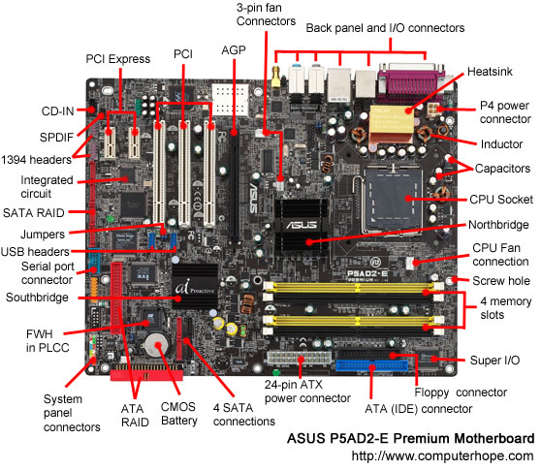

Hardware Parts of a computer ….
Mother board
Is the main circuit board inside the computer
Has tiny electronic circuits and other components on it
Connects input, output, and processing devices together
(CPU, Memory, Hard Drive, DVD Drive)
Expansion Cards
Video Card – is connected to the computer monitor and is used to display information on the monitor.
Network interface card
Notes:
The motherboard is a printed circuit board that is the foundation of a computer, located at the bottom of the computer case. It allocates power to the CPU, RAM, and all other computer hardware components. Most importantly, the motherboard allows hardware components to communicate with one another.
The picture above is the ASUS P5AD2-E motherboard with names of each major component of the motherboard. Clicking on the image below gives you a larger more detailed version of the picture below.

Slide 5

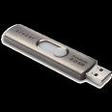


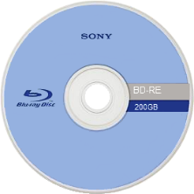
Hardware Parts of a computer ….
Storage Devices
Hard Disk
Flash Drive
CD-ROM
DVD-ROM
BD-RE
Front of an experimental 200 GB rewritable Blu-ray Disc
Note:
current optical disc technologies such as DVD, DVD±R, DVD±RW, and DVD-RAM rely on a red laser to read and write data, the new format uses a blue-violet laser instead, hence the name Blu-ray.
Notes:
You use storage devices to store computer information. Storage devices come in many forms. Some examples are hard drive or disk, CD-ROM, floppy disk, and DVD-ROM. Storage devices can be divided into two types, internal storage devices and external storage devices. Some common storage devices are described in the following list.
While current optical disc technologies such as DVD, DVD±R, DVD±RW, and DVD-RAM rely on a red laser to read and write data, the new format uses a blue-violet laser instead, hence the name Blu-ray. Despite the different type of lasers used, Blu-ray products can easily be made backwards compatible with CDs and DVDs through the use of a BD/DVD/CD compatible optical pickup unit.
Blu-ray Discs to hold 25GB/50GB. Recent development by Pioneer has pushed the storage capacity to 500GB on a single disc by using 20 layers.

Slide 6
Computer Software's
1. Operating Systems:
Is the most important software on the computer
Controls and manages the hardware connected to your computer
Provides an interface that helps you to interact with the computer
Ensures that your computer is functioning properly
Windows XP, 7, 8, 10 and Unix are examples of the operation system.
Can be either text-based or graphics-based.
Application Programs: there are many types of programs
Some programs allow you to perform tasks such as writing letters, doing calculations, or sending e-mail messages.
Other programs allow you to create illustrations, play games, watch movies, or communicate with other computer users.
Notes:
The hardware and the operating system together are referred to as a platform. Programs, also called applications, use this platform to perform tasks. There are many types of programs. Some programs allow you to perform tasks such as writing letters, doing calculations, or sending e-mail messages. For example, a word processor, such as Microsoft® Office Word 2010/2016, is a program that helps you create a letter.
Other programs allow you to create illustrations, play games, watch movies, or communicate with other computer users.

Slide 7
Data Representation: Unit of Measurement
Programs process data that you provide as input to your computer
Data can be in the form of text, graphics, audio, or video depending on the type of program
Program processes the data and displays the output on the screen. You can save this output in a file.
What units of measurement are used for data storage?
The smallest unit of measurement used for measuring data is a bit
A single bit can have a value of either 0 or 1
It may contain a binary value (such as On/Off or True/False)
a byte, or eight bits, is used as the fundamental unit of measurement for data. A byte can store 2⁸ or 256 different values, which is sufficient to represent standard ASCII characters
Notes:
A byte can store 2⁸ or 256 different values, which is sufficient to represent standard ASCII characters, such as letters, numbers and symbols.
Since most files contain thousands of bytes, file sizes are often measured in kilobytes. Larger files, such as images, videos, and audio files, contain millions of bytes and therefore are measured in megabytes. Modern storage devices can store thousands of these files, which is why storage capacity is typically measured in gigabytes or even terabytes. Larger units of measurement are usually reserved for measuring the sum of multiple storage devices or the capacity of large data storage networks.

Slide 8
List of all the standard units of measurement used for data storage
Unit | Value | Size
bit (b) | 0 or 1 | 1/8 of a byte
byte (B) | 8 bits | 1 byte
kilobyte (KB) | 1000¹ bytes | 1,000 bytes
megabyte (MB) | 1000² bytes | 1,000,000 bytes
gigabyte (GB) | 1000³ bytes | 1,000,000,000 bytes
terabyte (TB) | 1000⁴ bytes | 1,000,000,000,000 bytes
petabyte (PB) | 1000⁵ bytes | 1,000,000,000,000,000 bytes
exabyte (EB) | 1000⁶ bytes | 1,000,000,000,000,000,000 bytes
zettabyte (ZB) | 1000⁷ bytes | 1,000,000,000,000,000,000,000 bytes
Notes:
NOTE: A lowercase "b" is used as an abbreviation for bits, while an uppercase "B" represents bytes. This is an important distinction, since a byte is 8x as large as a bit.
For example, 100 KB (kilobytes) = 800 Kb (kilobits).

Slide 9
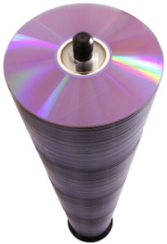

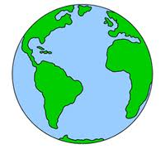



Computer Software's
One page
of text
One song
One movie
6 million
books
55 storeys
of DVD
Data
up to
2003
Data
in 2011
30KB
5 MB
5 GB
1 TB
1 PB
1.8 ZB
5 EB
Who has this data size ???
Byte Kilobyte Megabyte Gigabyte Terabyte Petabyte Exabyte Zettabyte Yottabyte
KB MB GB TB PB EB ZB YB
1000 bytes 1000 KB 1000 MB 1000 GB 1000 TB 1000 PB 1000 ZB 1000YB
1s 20 mins 11 days 30 years 300 30 million 30 billion ….
centuries years years

Slide 10
File system management
A file system (sometimes written filesystem) is the way in which files are named and where they are placed logically for storage and retrieval
All OS have file systems in which files are placed somewhere in a hierarchical form called tree structure
Files are placed at leaves in a tree structured directory system
E.g: Root Directory/Directory/sub-directory/…/ file
Notes:
DOS, Windows, OS/2, Macintosh and Unix-based operating systems (OSes) all have file systems in which files are placed somewhere in a hierarchical (tree) structure. A file is placed in a directory (folder in Windows) or subdirectory at the desired place in the tree structure.
A tree structure is an algorithm for placing and locating files (called records or keys) in a database. The algorithm finds data by repeatedly making choices at decision points called nodes. A node can have as few as two branches (also called children), or as many as several dozen.

Slide 11
Types of Computers
Supercomputers:
The highly calculation-intensive tasks can be effectively performed by means of supercomputers. Quantum physics, mechanics, weather forecasting, molecular theory are best studied by means of supercomputers.
Mainframe Computers:
Large organizations use mainframes for highly critical applications such as bulk data processing and ERP. Most of the mainframe computers have capacity to host multiple operating systems
Microcomputers:
A computer with a microprocessor and its central processing unit is known as a microcomputer.
Personal computers
Desktops:
Laptops:
Personal Digital Assistants (PDAs):
Notes:
Microcomputers: A computer with a microprocessor and its central processing unit is known as a microcomputer. They do not occupy space as much as mainframes. When supplemented with a keyboard and a mouse, microcomputers can be called as personal computers. A monitor, a keyboard and other similar input output devices, computer memory in the form of RAM and a power supply unit come packaged in a microcomputer. These computers can fit on desks or tables and serve as the best choices for single-user tasks.

Slide 12
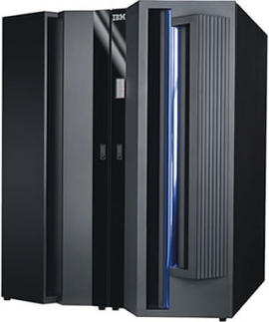
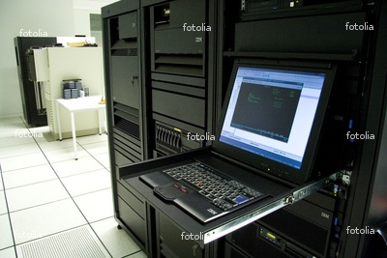
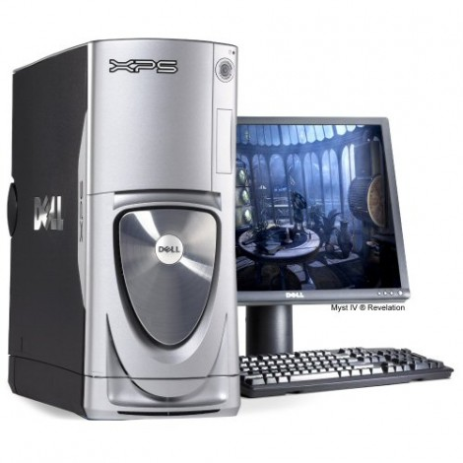
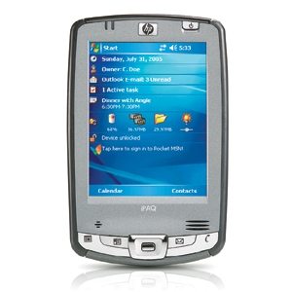
Types of Computers

Slide 13
Major parts to consider during purchasing a computer
Before you decide purchasing a computer:
Know your requirements and purpose
Does your requirement need high graphics?
Do you carry it and travel long distance?
How much do you want to invest?
Battery
First:
Processor speed, type and its version
Memory
Disc storage size or screen size
Second:
Weight
Battery power
Available ports and DVD/BD type

Slide 14
Computer networks
A collection of computing devices connected in order to communicate and share resources
Connections between computing devices can be physical using wires or cables or wireless using radio waves or infrared signals
Any device on a network is called Node or Host
The speed with which data is moved from one place to another on a network bandwidth (data transfer rate)
A set of rules that defines how data is formatted and processed on a network is called Protocols
Notes:
Data transfer rate is a key issue in computer networks

Slide 15
Types of Networking
Local Area network (LAN)
A network that connects a relatively small number of machines in a relatively close geographical area
Ring topology connects all nodes in a closed loop on which messages travel in one direction
Star topology centers around one node to which all others are connected and through which all messages are sent
Bus topology nodes are connected to a single communication line that carries messages in both directions

Slide 16
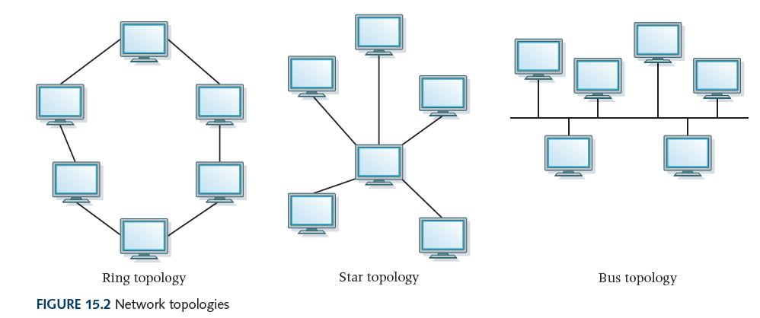
Types of LAN
Ring, star and bus

Slide 17
Internet vs intranet
The Internet, as we know it today, is essentially the ultimate wide-area network, spanning the entire globe
Intranet : (computing) an internal network that makes use of internet technology
Internal or a private network of an organization based on internet protocol technology and accessed over the internet
Notes:
An intranet is a network based on TCP/IP protocols (an internet) belonging to an organization, usually a corporation, accessible only by the organization's members, employees, or others with authorization.
An intranet is meant for the exclusive use of the organization and its associates (customers, employees, members, suppliers, etc.) and is protected from unauthorized access with security systems such as firewalls. Intranets provide services such as email, data storage, and search and retrieval functions, and are employed in disseminating policy manuals and internal directories for the employees, price and product information for the customers, and requirements and specifications for the suppliers.

Slide 18
LAN, WAN, MAN & VPN
Local Area Network (LAN)
network that interconnects computers within a limited area such as a residence, school, laboratory, university campus or office building
Wide-Area Network (WAN)
A network that connects local-area networks over a potentially large geographic distance
Metropolitan-area network (MAN)
The communication infrastructures that have been developed in and around large cities
Notes:
VPN=Virtual Private Network is a type of private network that uses public telecommunication, such as the Internet, instead of leased lines to communicate.

Slide 19
LAN, WAN, MAN & VPN
VPN? VIRTUAL PRIVATE NETWORK
A virtual private network (VPN) extends a private network across a public network, and enables users to send and receive data across shared or public networks as if their computing devices were directly connected to the private network.
Applications running across the VPN may therefore benefit from the functionality, security, and management of the private network.
VPNs may allow employees to securely access a corporate intranet while located outside the office.
Notes:
VPN=Virtual Private Network is a type of private network that uses public telecommunication, such as the Internet, instead of leased lines to communicate.

Slide 20
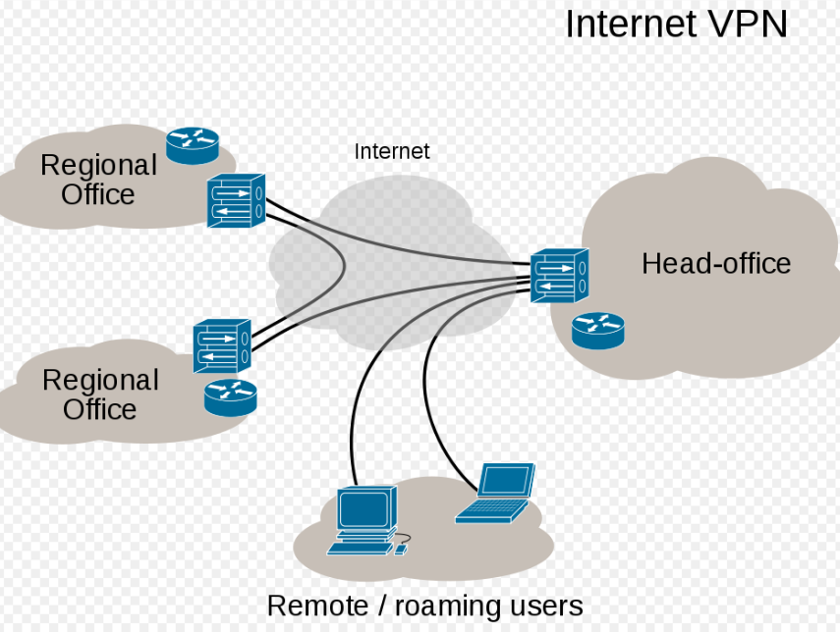
LAN, WAN, MAN & VPN
Notes:
VPN=Virtual Private Network is a type of private network that uses public telecommunication, such as the Internet, instead of leased lines to communicate.

Slide 21
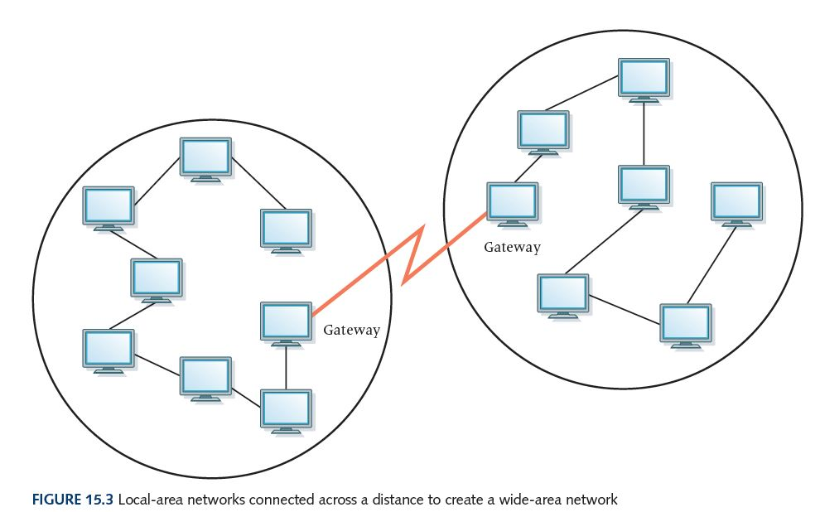
Geteway
Often one particular node on a LAN is set up to serve as a gateway to handle all communication going between that LAN and other networks
Communication between networks is called internetworking
Notes:
VPN=Virtual Private Network is a type of private network that uses public telecommunication, such as the Internet, instead of leased lines to communicate.

Slide 22
Internet :
Well, nobody does. No single person or company owns the Internet or even controls it entirely. As a wide-area network, it is made up of many smaller networks. These smaller networks are often owned and managed by a person or organization. The Internet, then, is really defined by how connections can be made between these networks.
Internet backbone A set of high-speed networks that carry Internet traffic. These networks are provided by companies such as AT&T, …
Internet service provider (ISP) A company that provides other companies or individuals with access to the Internet
Notes:
Broadband A connection in which transfer speeds are faster than 128 bits per second
DSL connections and cable modems are broadband connections
The speed for downloads (getting data from the Internet to your home computer) may not be the same as uploads (sending data from your home computer to the Internet)
Internet connections : Various technologies available to connect a home computer to the Internet (ADSL, ADSL2+, VDSL2, xDSL, cable modem)

Slide 23
Internet Connections
Broadband A connection in which transfer speeds are faster than 380 bits per second
Digital Subscriber Line (DSL) connections and cable modems are broadband connections
The speed for downloads (getting data from the Internet to your home computer) may not be the same as uploads (sending data from your home computer to the Internet)

Slide 24
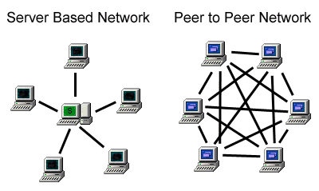
Networking Communications
There are two type of network communication :
Peer-to-Peer (P2P)
Client-Server
P2P
Network built and sustained by resources of each participant
Peers act as both client and server
Issues:
volatility, scalability, legality

Slide 25
Networking Communications ….
2: Client – Server
Clients specialize in user interface
Servers specialize in managing data and application logic
Asymmetric relationship
Client predominately makes requests, server makes replies
Client
host
Client
host
Note:
communication between computers or connected devices within the network is done based on standard set of rules and regulations.
These rules and regulation is known as Protocols.
Server
host

Slide 26
Some common protocols ….
A protocol is a convention or standard that controls or enables the connection, communication, and data transfer between computing endpoints
a protocol can be defined as the rules governing the syntax, semantics, and synchronization of communication
Some Examples of protocols grouped in their respective layers
Application layer ➔ DNS, TFTP, SSL, FTP, HTTP, POP3, SMTP, SNMP, SSH, Telnet,
Transport Layer ➔ TCP, UDP
Internet Protocol Layer ➔ IP, Ipsec, DHCP
Data Link Layer ➔ ARP, MAC (Ethernet, DSL, ISDN, …)
Notes:
Protocols may be implemented by hardware, software, or a combination of the two. At the lowest level, a protocol defines the behavior of a hardware connection.
The Dynamic Host Configuration Protocol (DHCP) is a standardized network protocol used on Internet Protocol (IP) networks for dynamically distributing network configuration parameters, such as IP addresses for interfaces and services.
The Domain Name System (DNS) is a hierarchical decentralized naming system for computers, services, or any resource connected to the Internet or a private network.
The File Transfer Protocol (FTP) is a standard network protocol used to transfer computer files between a client and server on a computer network.
HTTP is the foundation of data communication for the World Wide Web.

Slide 27
Some common protocols ….
TCP stands for Transmission Control Protocol
TCP software breaks messages into packets, hands them off to the IP software for delivery, and then orders and reassembles the packets at their destination
UDP stands for User Datagram Protocol
It is an alternative to TCP
The main difference is that TCP is highly reliable, at the cost of decreased performance, while UDP is less reliable, but generally faster
IP stands for Internet Protocol
IP software deals with the routing of packets through the maze of interconnected networks to their final destination
Notes:
The Internet Protocol (IP) is the principal communications protocol in the Internet protocol suite for relaying datagrams across network boundaries. Its routing function enables internetworking, and essentially establishes the Internet.
IP has the task of delivering packets from the source host to the destination host solely based on the IP addresses in the packet headers. For this purpose, IP defines packet structures that encapsulate the data to be delivered. It also defines addressing methods that are used to label the datagram with source and destination information.

Slide 28
IP Addressing (Network Addressing)
What is Internet Protocol (IP) address mean?
The address of a connected device in an IP network (TCP/IP network)
Every desktop and laptop computer, server, scanner, printer, modem, router, smartphone and tablet is assigned an IP address, and every IP packet traversing an IP network contains a source IP address and a destination IP address.
IP addresses are written in "dotted decimal" notation, which is four sets of numbers separated by decimal points; for example, 204.171.64.2. and 10.10.10.120
Instead of the domain name of a Web site, the actual IP address can be entered into the browser. However, the Domain Name System (DNS) exists so users can enter computerlanguage.com instead of an IP address, and the domain (the URL) is converted to the numeric IP address (see DNS).
Notes:
IP by itself can be compared to something like the postal system. It allows you to address a package and drop it in the system, but there's no direct link between you and the recipient.

Slide 29
IP Addressing (Network Addressing) ….
There are currently two version of Internet Protocol (IP):
IPv4 and a new version called IPv6
IPv6 is an evolutionary upgrade to the Internet Protocol. IPv6 will coexist with the older IPv4 for some time.
IPv4 (Internet Protocol Version 4):
is the fourth revision of the Internet Protocol (IP) used to identify device on a network through an addressing system
is the most widely deployed Internet protocol used to connect devices to the Internet. IPv4 uses a 32-bit address scheme allowing for a total of 2^32 addresses (just over 4 billion addresses)
IPv6 (Internet Protocol Version 6) :
It is also called IPng (Internet Protocol next generation) and it is the newest version of the Internet Protocol (IP) ➔ uses 128 bit
Will replace the current version of IPv4 (Internet Protocol Version 4) in the future
IPv6 is designed to allow the Internet to grow steadily, both in terms of the number of hosts connected and the total amount of data traffic transmitted
Notes:
IP by itself can be compared to something like the postal system. It allows you to address a package and drop it in the system, but there's no direct link between you and the recipient.
With the growth of the Internet it is expected that the number of unused IPv4 addresses will eventually run out because every device -- including computers, smartphones and game consoles -- that connects to the Internet requires an address.
A new Internet addressing system Internet Protocol version 6 (IPv6) is being deployed to fulfill the need for more Internet addresses.

Slide 30
IP Addressing (Network Addressing) ….
Public and Private Addresses:
The entire local network is exposed to the public Internet via one public IP address for homes and small businesses. Large companies use several public IPs.
In contrast, the devices within the network use private addresses not reachable from the outside world, and the routers and firewalls make sure of it
these same private IP address ranges are used in every network. (192.168.1.1)
Static and Dynamic IP:
Network infrastructure devices such as servers, routers and firewalls are typically assigned permanent "static" IP addresses
The client machines can also be assigned static IPs by a network administrator, but most often are automatically assigned "dynamic" IP addresses via software (see DHCP)
Example :
Cable and DSL modems are typically assigned dynamic IPs for home users and static IPs for business users
Notes:
An IP address is a logical address that is assigned by software residing in a server or router (see DHCP). In order to locate a device in the network, the logical IP address is converted to a physical address by a function within the TCP/IP protocol software (see ARP). The physical address is actually built into the hardware (see MAC address).

Slide 31
Virtualization and Virtual Machine
What is virtual Machine:
A Virtual Machine is a software that creates a virtualized environment between the computer platform and the end user in which the end user can operate software.
A virtual machine provides an interface identical to the underlying bare hardware
Virtualization:
Virtualization is an abstraction layer that decouples the physical hardware from the operating system to deliver greater IT resource utilization and flexibility
Notes:
It allows multiple virtual machines, with heterogeneous operating systems to run in isolation, side-by-side on the same physical machine.
Each virtual machine has its own set of virtual hardware (e.g., RAM, CPU, NIC, etc.) upon which an operating system and applications are loaded.
The operating system creates the illusion of multiple processes, each executing on its own processor with its own (virtual) memory.
The host software that provides virtualization is often referred to as a virtual machine monitor (VMM) or hypervisor.
The VMM gives each virtual machine an illusion of a complete computer to itself.

Slide 32
Virtualization and …
Benefits:
Partitioning
Multiple applications and operating systems can be supported within a single physical system.
Isolation
Virtual machines are completely isolated from the host machine and other virtual machines. If a virtual machine crashes, all others are unaffected.
Note:
Virtualizing hardware resources: CPU, I/O, memory, networking and GUI
The virtualizing software is called VMM (virtual machine monitor) or hypervisor
Application
Application
OS
OS
Virtual Machine
Hardware
Notes:
Virtual machines allow you to run an operating system in a window on your desktop. Use them to run software made for other operating systems, experiment with different operating systems, and sandbox software.
A virtual machine program is a computer program that creates a virtual computer system, complete with virtual hardware devices.

Slide 33
Domain Name system
The Domain Name System (DNS) is the phonebook of the Internet.
Humans access information online through domain names, like amazon.com or espn.com.
Web browsers interact through Internet Protocol (IP) addresses.
DNS translates domain names to IP addresses so browsers can load Internet resources.
Each device connected to the Internet has a unique IP address which other machines use to find the device.
DNS servers eliminate the need for humans to memorize IP addresses such as 192.168.1.1 (in IPv4), or more complex newer alphanumeric IP addresses such as 2400:cb00:2048:1::c629:d7a2 (in IPv6).
Notes:
In USA there are around 13 top level domain names all over the world

Slide 34
Domain Name system
A hostname consists of the computer name followed by the domain name, server1.sholla.com is an example of a computer name (host name).
Amazon.com or sholla.com is the domain name
A domain name is separated into two or more sections that specify the organization, and possibly a subset of an organization, of which the computer is a part
Two organizations can have a computer named the same thing because the domain name makes it clear which one is being referred to.
Server1.amazon.com or server1.sholla.com
Notes:
In USA there are around 13 top level domain names all over the world

Slide 35
Domain Name system …..
The domain name system (DNS) is chiefly used to translate hostnames into numeric IP addresses
DNS is an example of a distributed database
If that server can resolve the hostname, it does so
If not, that server asks another domain name server
Note: learn about DNS servers and what they are used for.

